Slide 1
PROGRAMMING II Pointer
Dr Suriyani Ariffin

Slide 2
Topics
Pointers
Memory addresses
Declaration
Dereferencing a pointer
Pointers to pointer
Static vs. dynamic objects
new and delete

Slide 3
Computer Memory
Each variable is assigned a memory slot (the size depends on the data type) and the variable’s data is stored there
Memory address:
1020
1024
1032
…
…
100
…
1024
…
a
Variable a’s value, i.e., 100, is
stored at memory location 1024
int a = 100;

Slide 4
Pointers
A pointer is a variable used to store the address of a memory cell.
We can use the pointer to reference this memory cell
Memory address:
1020
1024
1032
…
…
100
…
1024
…
integer
pointer

Slide 5
Major advantages of pointers are:
It allows management of structures which are allocated memory dynamically.
It allows passing of arrays and strings to functions more efficiently.
It makes possible to pass address of structure instead of entire structure to the functions.

Slide 6
Pointer Types
Pointer
C++ has pointer types for each type of object
Pointers to int objects
Pointers to char objects
Pointers to user-defined objects
(e.g., RationalNumber)
Even pointers to pointers
Pointers to pointers to int objects

Slide 7
Pointer Variable
Declaration of Pointer variables
type* pointer_name;
//or
type *pointer_name;
where type is the type of data pointed to (e.g. int, char, double)
Examples:
int *n;
RationalNumber *r;
int **p; // pointer to pointer

Slide 8
Address Operator &
The "address of " operator (&) gives the memory address of the variable
Usage: &variable_name
Memory address:
1020
1024
…
…
100
…
…
…
a
int a = 100;
//get the value,
cout << a; //prints 100
//get the memory address
cout << &a; //prints 1024

Slide 9
Address Operator &
Memory address:
1020
1024
1032
…
88
100
…
…
…
a
b
#include <iostream>
using namespace std;
void main(){
int a, b;
a = 88;
b = 100;
cout << "The address of a is: " << &a << endl;
cout << "The address of b is: " << &b << endl;
}
Result is:
The address of a is: 1020
The address of b is: 1024

Slide 10
Pointer Variables
The value of pointer p is the address of variable a
A pointer is also a variable, so it has its own memory address
Memory address:
1020
1024
1032
…
88
100
…
1024
…
a
p
int a = 100;
int *p = &a;
cout << a << " " << &a <<endl;
cout << p << " " << &p <<endl;
Result is:
100 1024
1024 1032

Slide 11
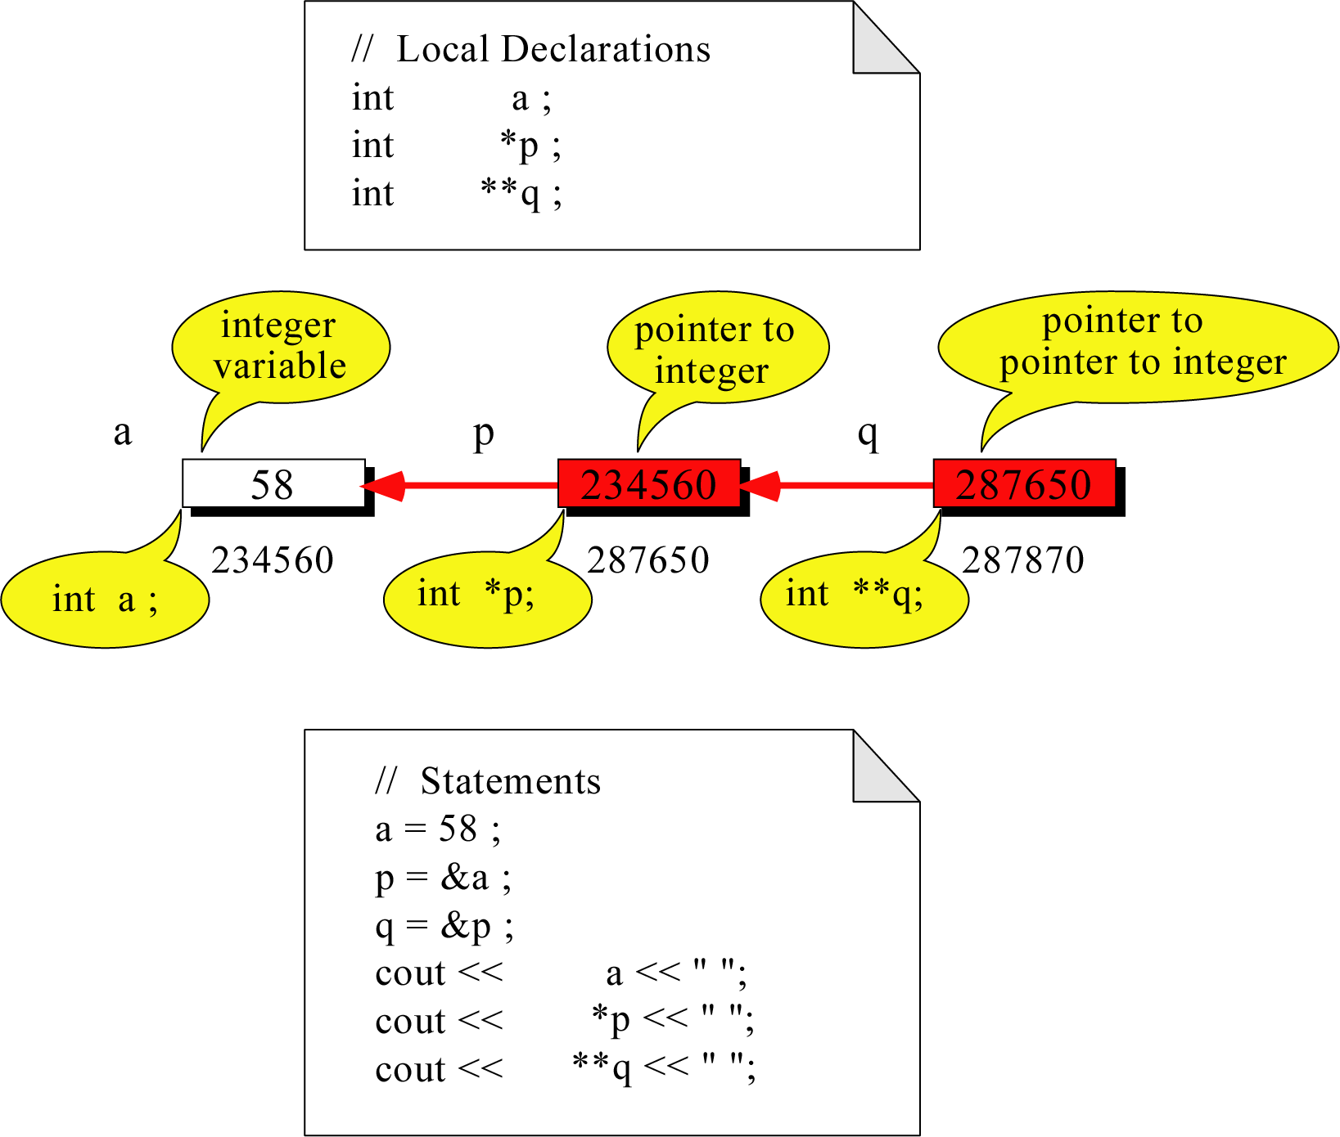
Pointer to Pointer
What is the output?
58 58 58

Slide 12
Dereferencing Operator *
We can access to the value stored in the variable pointed to by using the dereferencing operator (*),
Memory address:
1020
1024
1032
…
88
100
…
1024
…
a
p
int a = 100;
int *p = &a;
cout << a << endl;
cout << &a << endl;
cout << p << " " << *p << endl;
cout << &p << endl;
Result is:
100
1024
1024 100
1032

Slide 13
Don’t get confused
Declaring a pointer means only that it is a pointer: int *p;
Don’t be confused with the dereferencing operator, which is also written with an asterisk (*). They are simply two different tasks represented with the same sign
int a = 100, b = 88, c = 8;
int *p1 = &a, *p2, *p3 = &c;
p2 = &b; // p2 points to b
p2 = p1; // p2 points to a
b = *p3; //assign c to b
*p2 = *p3; //assign c to a
cout << a << b << c;
Result is:
888

Slide 14
A Pointer Example
Memory Layout
The code
void doubleIt(int x, int * p)
{
*p = 2 * x;
}
int main(int argc, const char * argv[])
{
int a = 16;
doubleIt(9, &a);
return 0;
}
Box diagram
main
16
p (8200)
8192
a
doubleIt
x (8196)
9
a (8192)
16
main
doubleIt
x
9
a gets 18
p
Notes:
Note the signature of main() – it’s an array parameter. And, like other examples we’ve given, it takes the number of elements as a parameter. Why?

Slide 15
Another Pointer Example
Let’s figure out:
value1==? / value2==?
Also, p1=? p2=?
#include <iostream>
using namespace std;
int main (){
int value1 = 5, value2 = 15;
int *p1, *p2;
p1 = &value1; // p1 = address of value1
p2 = &value2; // p2 = address of value2
*p1 = 10; // value pointed to by p1=10
*p2 = *p1; // value pointed to by p2= value // pointed to by p1
p1 = p2; // p1 = p2 (pointer value copied)
*p1 = 20; // value pointed to by p1 = 20
cout << "value1==" << value1 << "/ value2==" << value2;
return 0;
}

Slide 16
Another Pointer Example
int a = 3;
char s = ‘z’;
double d = 1.03;
int *pa = &a;
char *ps = &s;
double *pd = &d;
% sizeof returns the # of bytes…
cout << sizeof(pa) << sizeof(*pa)
<< sizeof(&pa) << endl;
cout << sizeof(ps) << sizeof(*ps)
<< sizeof(&ps) << endl;
cout << sizeof(pd) << sizeof(*pd)
<< sizeof(&pd) << endl;

Slide 17
NULL pointer
NULL is a special value that indicates an empty pointer
If you try to access a NULL pointer, you will get an error
int *p;
p = 0;
cout << p << endl; //prints 0
cout << &p << endl;//prints address of p
cout << *p << endl;//Error!

